Slide 1






BUILDING EVENT-DRIVEN SYSTEMS WITH APACHE KAFKA
Brian Ritchie
CTO, XeoHealth
@brian_ritchie
brian.ritchie@gmail.com
http://www.dotnetpowered.com
2016

Slide 2
Event-Driven systems
Definition
Event-driven architecture, also known as message-driven architecture, is a software architecture pattern promoting the production, detection, consumption of, and reaction to events. An event can be defined as "a significant change in state".
https://en.wikipedia.org/wiki/Event-driven_architecture

Slide 3
Event-Driven systems are about unlocking data
Data is the driving force behind innovation
Event-driven systems allow you to unlock the data – and unlock the innovation.

Slide 4
Events are the “what happened” data
It’s about recording “what happened”, but not coupling it to the “how”
It’s the “transactions” of your system
Product Views
Completed Sales
Page Visits
Site Logins
Shipping Notifications
Inventory Received
IoT
…and much more

Slide 5
Events – a healthcare example
What happened?
A patient received a set of services
Healthcare
Claim
Event
Stream
You don’t need to integrate with consumers or even know about a future uses of your data
More…
Data Lake
Archive
Contract &
Pricing
Fraud
Detection
Disease
Trending

Slide 6
Event-Driven systems make scalability easier
Scalability of processing
Scalability of design
Scalability of change

Slide 7
Event-Driven systems require infrastructure
Queue / Stream
Persistence
Distribution
Pub / Sub

Slide 8
Apache Kafka is the infrastructure
Apache Kafka is publish-subscribe messaging rethought as a distributed commit log.
Developed by LinkedIn
Written in Java
Open Sourced in 2011 and graduated Apache Incubator in 2012
Unique features of Kafka
Super fast
Distributed & Replicated out of the box
Extremely low cost

Slide 9










Who uses Apache Kafka?
A few small companies you might have heard of…
Notes:
http://blog.underdog.io/post/107602021862/inside-datadogs-tech-stack

Slide 10





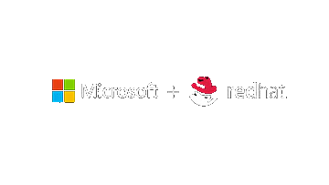
Microsoft supports kafka
Microsoft sponsors the Kafka summit, releases Kafka .NET driver on GitHub, and even buys LinkedIn. That is some Kafka love.
Microsoft ♥ Linux
Nearly 1 in 3 VMs are Linux
Microsoft ♥ Open Source
Microsoft moves to GitHub

Slide 11
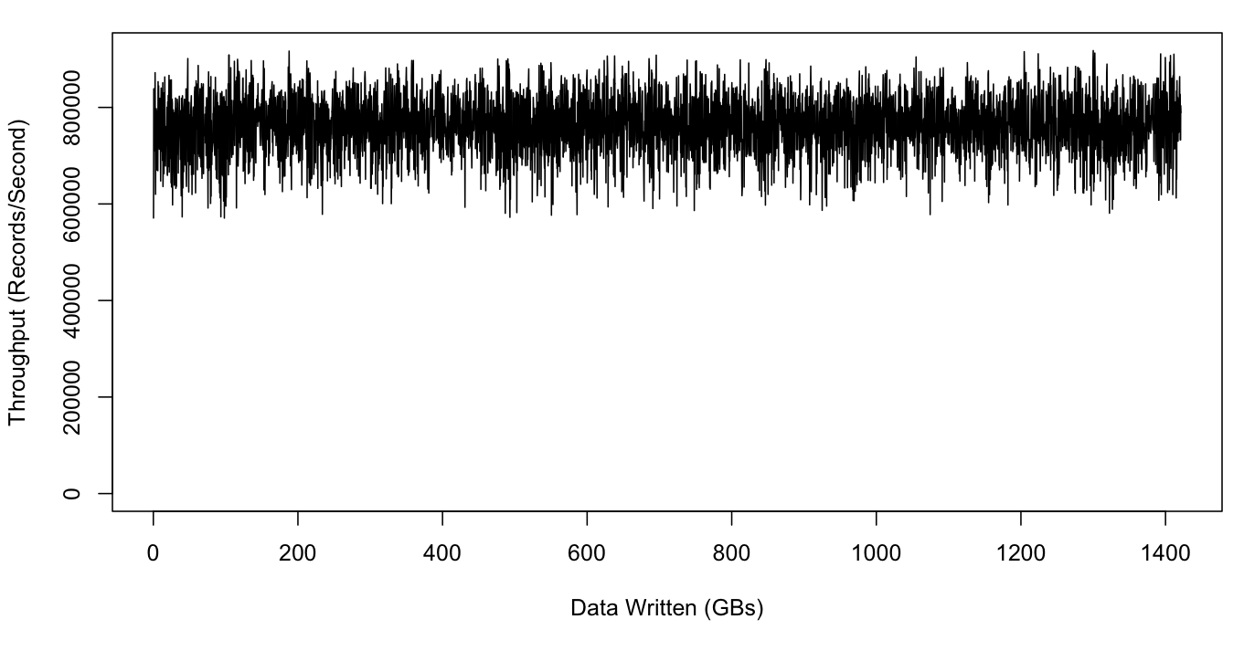
Apache Kafka – performance
Kafka performs amazingly well on modest hardware.
Producers and consumers simultaneously accessing cluster.
Test on the LinkedIn Engineering Blog:
3 machines in Kafka cluster, 3 to generate load
6 SATA drives each, 32 GB RAM each
1 GB Ethernet
800,000
Records/second!
https://engineering.linkedin.com/kafka/benchmarking-apache-kafka-2-million-writes-second-three-cheap-machines
Notes:
https://engineering.linkedin.com/kafka/benchmarking-apache-kafka-2-million-writes-second-three-cheap-machines

Slide 12
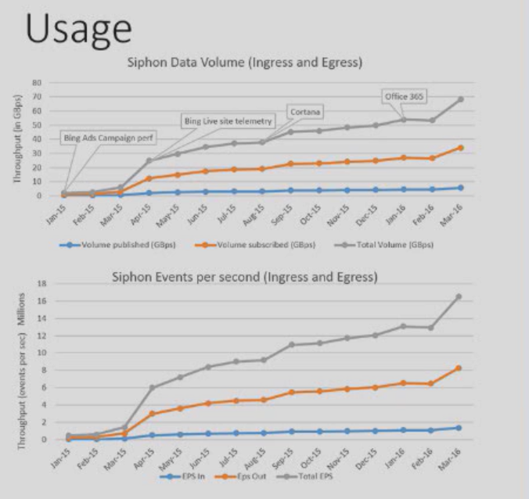
Apache Kafka – performance
Microsoft has one of the largest Kafka installations called “Siphon”
1.3 million
Events per second at peak
~1 trillion
Events per day at peak
3.5 petabytes
Processed per day
1,300
Production brokers
http://www.confluent.io/kafka-summit-2016-users-siphon-near-rea-time-databus-using-kafka
Notes:
https://engineering.linkedin.com/kafka/benchmarking-apache-kafka-2-million-writes-second-three-cheap-machines

Slide 13
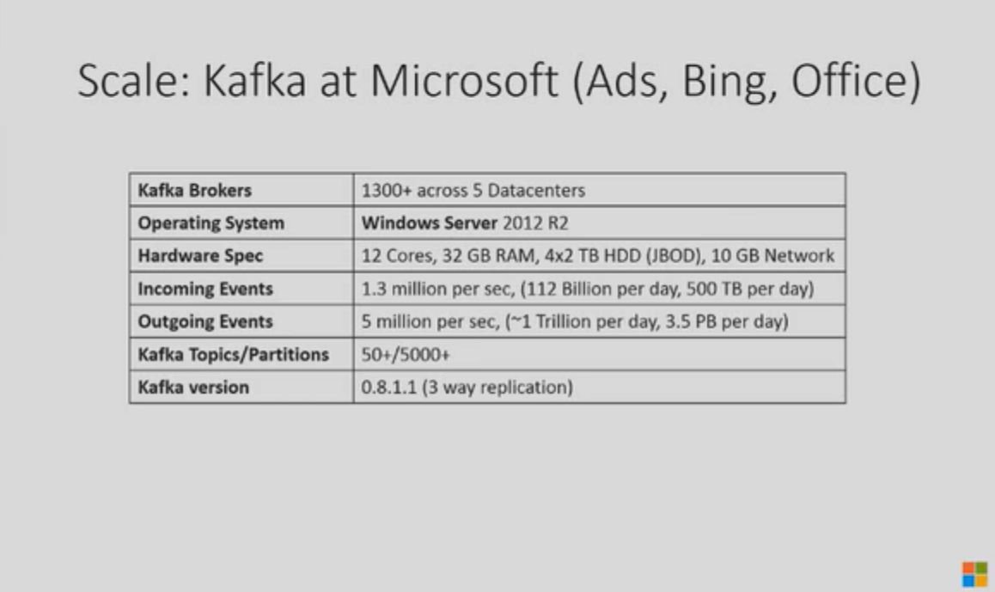
Apache Kafka – performance
Microsoft has one of the largest Kafka installations called “Siphon”
http://www.confluent.io/kafka-summit-2016-users-siphon-near-rea-time-databus-using-kafka
Availability & Latency monitor for Kafka using Canary messages
https://github.com/Microsoft/Availability-Monitor-for-Kafka
Notes:
https://engineering.linkedin.com/kafka/benchmarking-apache-kafka-2-million-writes-second-three-cheap-machines

Slide 14
Apache Kafka – architecture
producer
producer
Producers publish messages to a Kafka topic
Kafka cluster
broker
broker
A Kafka cluster is made up of one or more brokers (nodes)
broker
Zookeeper
Kafka uses Zookeeper for configuration
consumer
consumer
consumer
Consumers subscribe to topics and process messages

Slide 15

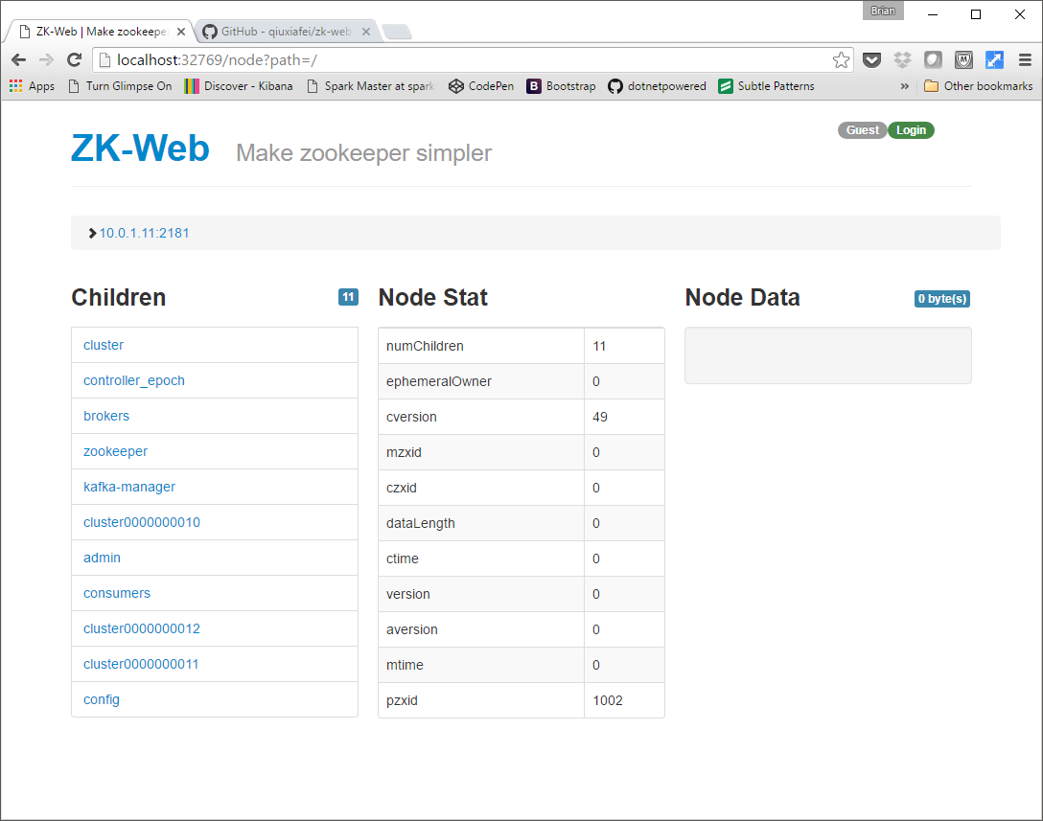
Apache Kafka – role of zookeeper
Apache ZooKeeper
zk-web: Web UI for ZooKeeper
What is ZooKeeper?
ZooKeeper is a centralized service for maintaining configuration information, naming, providing distributed synchronization, and providing group services to distributed applications.
Role of ZooKeeper in Kafka
It is responsible for: maintaining consumer offsets and topic lists, leader election, and general state information.
https://github.com/qiuxiafei/zk-web
Or get the Docker container

Slide 16
Apache Kafka – topics
consumer
reads
Kafka topic
Producers write messages to the end of a partition
Messages can be round robin load balanced across partitions or assigned by a function.
writes
producer
Partition 0
0
1
2
3
4
5
Partition 1
0
1
2
3
4
5
writes
Consumers read from the lowest offset to the highest
Unlike most queuing systems, state is not maintained on the server. Each consumer tracks its own offset.
Partition 2
0
1
2
3
4
producer
reads
consumer

Slide 17
Apache Kafka – more on partitions
Partitions for scalability
The more partitions you have, the more throughput you get when consuming data.
Each partition must fit entirely on a single server.
Partitions for ordering
Kafka only guarantees message order within the same partition.
If you need strong ordering, make sure that data is pinned to a single partition based on some sort of key

Slide 18
Apache Kafka – Persistence
All messages are written to disk and replicated.
Messages are not removed from Kafka when they are read from a topic.
A cleanup process will remove old messages based on a sliding timeframe.
Kafka topic
Partition 0
0
1
2
3
4
5
Partition 1
0
1
2
3
4
5
Partition 2
0
1
2
3
4

Slide 19
Apache Kafka – consumer groups
Consumer Group 1
consumer
consumer
reads
reads
Each consumer group is a “logical subscriber”
Messages are processed in parallel by consumers
Only one consumer is assigned to a partition in a consumer group.
Kafka topic
Partition 0
Partition 1
Partition 2
Partition 3
reads
reads
reads
reads
consumer
1
consumer
2
consumer
3
consumer
4
Consumer Group 2
Note: consumers are responsible for handling duplicate messages. These could be caused by failures of another consumer in the group.

Slide 20

Apache Kafka – SERIALIZATION
Pick a format!
JSON
BSON http://bsonspec.org/implementations.html
PROTOCOL BUFFERS https://github.com/google/protobuf
BOND https://github.com/Microsoft/bond
AVRO https://avro.apache.org/index.html

Slide 21
Apache Kafka – getting started
Install Kafka & ZooKeeper
https://dzone.com/articles/running-apache-kafka-on-windows-os
Install JDK
Install ZooKeeper
Install Kafka
Start Kafka & ZooKeeper
Start ZooKeeper
C:\bin\zookeeper-3.4.8\bin>zkServer.cmd
Start Kafka
C:\bin\kafka_2.11-0.8.2.2>.\bin\windows\kafka-server-start.bat .\config\server.properties

Slide 22
Apache Kafka – getting started
Create a topic
kafka-topics.bat --create --zookeeper localhost:2181 --replication-factor 1 --partitions 1 --topic SampleTopic1
Other Useful Topic Commands
List Topics
kafka-topics.bat --list --zookeeper localhost:2181
Describe Topics
kafka-topics.bat --describe --zookeeper localhost:2181 --topic [Topic Name]

Slide 23
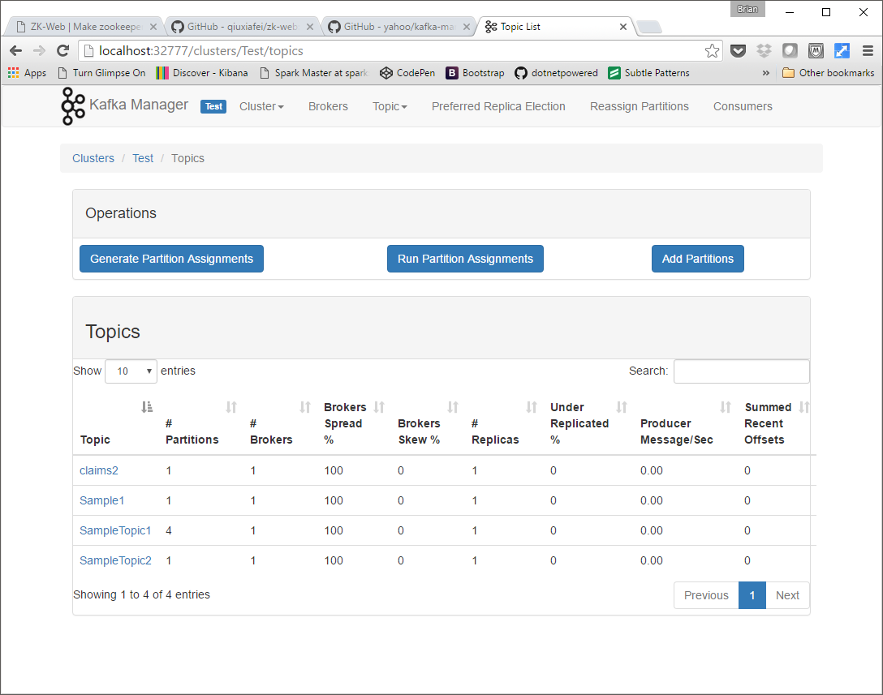
Kafka manager
A tool for managing Apache Kafka created by Yahoo.
https://github.com/yahoo/kafka-manager
Or get the Docker container

Slide 24
DEMO
Producing and consuming message in C#
Sample code:
https://github.com/dotnetpowered/StreamProcessingSample

Slide 25

Apache
Apache Spark is a fast and general engine for large-scale data processing, Runs programs up to 100x faster than Hadoop MapReduce in memory, or 10x faster on disk.
Spark Streaming makes it easy to build scalable fault-tolerant streaming applications. https://spark.apache.org/streaming/
Supports streaming directly from Apache Kafka. http://spark.apache.org/docs/latest/streaming-kafka-integration.html

Slide 26
Apache - firing up the cluster
Spark is made up of master and slave processes…
Start the master
Start one or more slaves
Access the Spark cluster via browser
spark-class org.apache.spark.deploy.master.Master
spark-class org.apache.spark.deploy.worker.Worker spark://spark-master:7077
http://spark-master:8080

Slide 27

Apache with mobius
Mobius is a .NET language binding for Spark. It is a Java wrapper for building workers in C# and other CLR-based languages.
Reference the Microsoft.SparkCLR Nuget Package
Build a console application utilizing the API
Submit your program to Spark using the following script
sparkclr-submit.cmd
--master spark://spark-master:7077
--jars <path>\runtime\dependencies\spark-streaming-kafka-assembly_2.10-1.6.1.jar
--exe StreamingRulesEngineHost.exe C:\src\StreamProcessing\StreamProcessingHost\bin\Debug
https://github.com/Microsoft/Mobius

Slide 28
DEMO
Consuming messages in C# using Spark
Sample code:
https://github.com/dotnetpowered/StreamProcessingSample

Slide 29

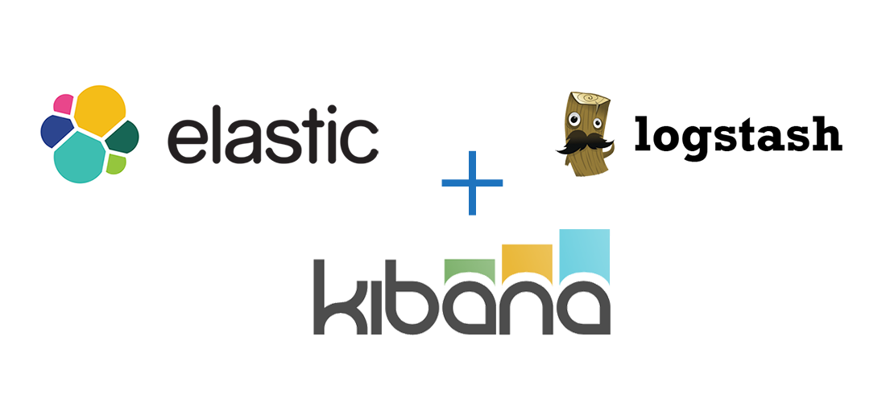
Using the ELK stack for integration & visualization
Use Logstack to ingest events and/or consume events. Allows for “ETL” and integration with tools such as Elastic Search.
Shipper
(for non-Kafka
enabled producers)
Indexer
search
https://www.elastic.co/blog/just-enough-kafka-for-the-elastic-stack-part1

Slide 30
Connecting kafka to elastic search
For consumers: Configure a Kafka input
input {
kafka {
zk_connect => "kafka:2181"
group_id => "logstash"
topic_id => "apache_logs"
consumer_threads => 16
}
}
Don’t forget about to select a codec for serialization!
Putting it all together:
C:\bin\logstash-2.3.2\bin>logstash -e "input { kafka { topic_id => 'SampleTopic2' } } output { elasticsearch { index=>'sample-%{+YYYY.MM.dd}' document_id => '%{docid}' } }"

Slide 31
Let’s review
Event-driven systems are a key ingredient to unlocking your organization’s potential. Make data available to current and future apps, improve scalability, and decrease complexity.
Kafka is foundational infrastructure for event-driven systems and is battle tested at scale.
The ecosystem building around Kafka is rich - allowing you to connect using various tools.

Slide 32
Questions?

Slide 33
Thank you!
2016
Brian Ritchie
CTO, XeoHealth
@brian_ritchie
brian.ritchie@gmail.com
Sample code:
https://github.com/dotnetpowered/StreamProcessingSample
http://www.dotnetpowered.com

